Slide 1
Introduction to Multivariable Calculus
Exploring Calculus with Multiple Variables

Slide 2
What is Multivariable Calculus?
Multivariable calculus, also known as vector calculus, extends the principles of calculus to functions of multiple variables.
It involves studying the behavior and properties of multivariable functions, including their rates of change, optimization, and integration.
Multivariable calculus plays a key role in many areas of mathematics, physics, engineering, and computer science.

Slide 3
Vectors and Vector Valued Functions
Vectors are mathematical objects that represent quantities with both magnitude and direction.
Vector-valued functions are functions that map a scalar variable to a vector.
In multivariable calculus, vectors and vector-valued functions are used to describe curves, surfaces, and higher-dimensional spaces.

Slide 4
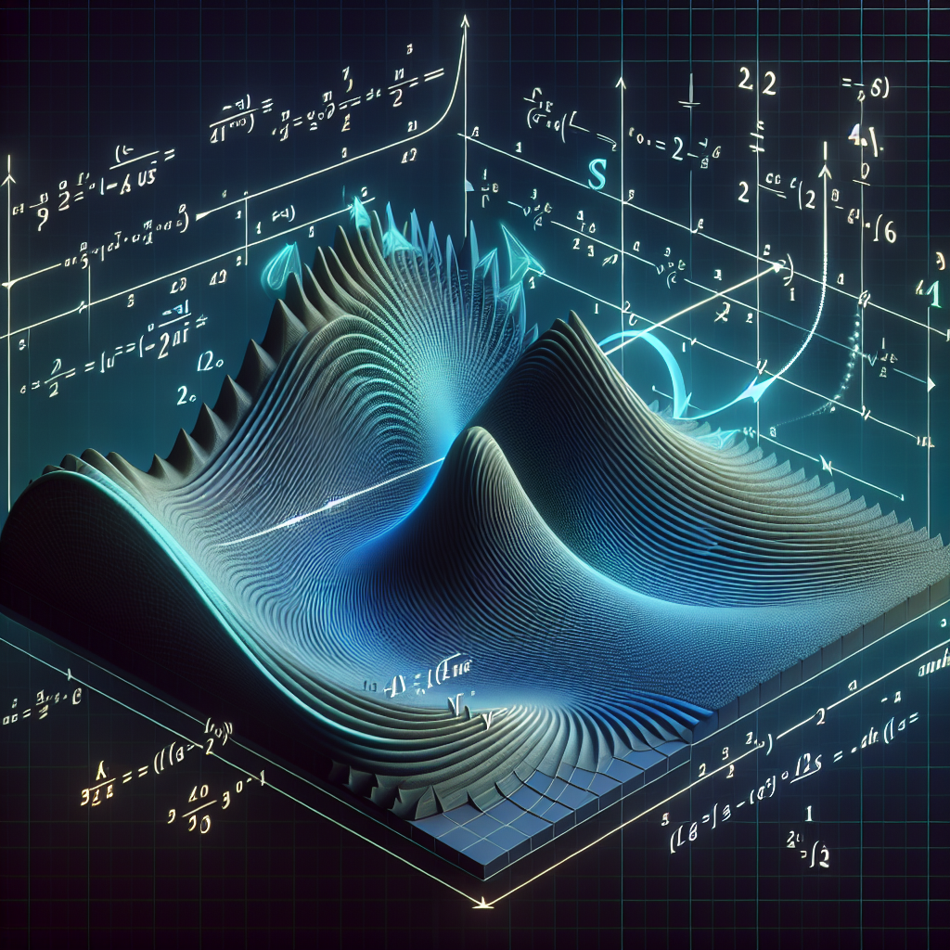
Partial Derivatives
Partial derivatives measure the rate of change of a multivariable function with respect to each of its variables, keeping all other variables constant.
They are useful for understanding how a function changes when only one variable changes, while others remain fixed.
Partial derivatives are often represented using gradients, which indicate the direction and magnitude of the steepest ascent of a function at a given point.
Partial Derivatives

Slide 5

Double and Triple Integrals
Double integrals compute the signed area under a surface in two-dimensional space.
Triple integrals compute the signed volume under a solid in three-dimensional space.
These integrals extend the concept of integration from single-variable calculus to multiple variables and are key for calculating quantities such as volume, mass, and probability.
Multiple Integrals

Slide 6
Gradient, Divergence, and Curl
Gradient, divergence, and curl are vector operators that operate on vector fields in multivariable calculus.
The gradient measures the direction and rate of change of a scalar function.
The divergence measures the outflow or influx of a vector field at a given point.
The curl measures the rotational behavior of a vector field.
These operators have various applications in physics, engineering, and fluid dynamics.

Slide 7
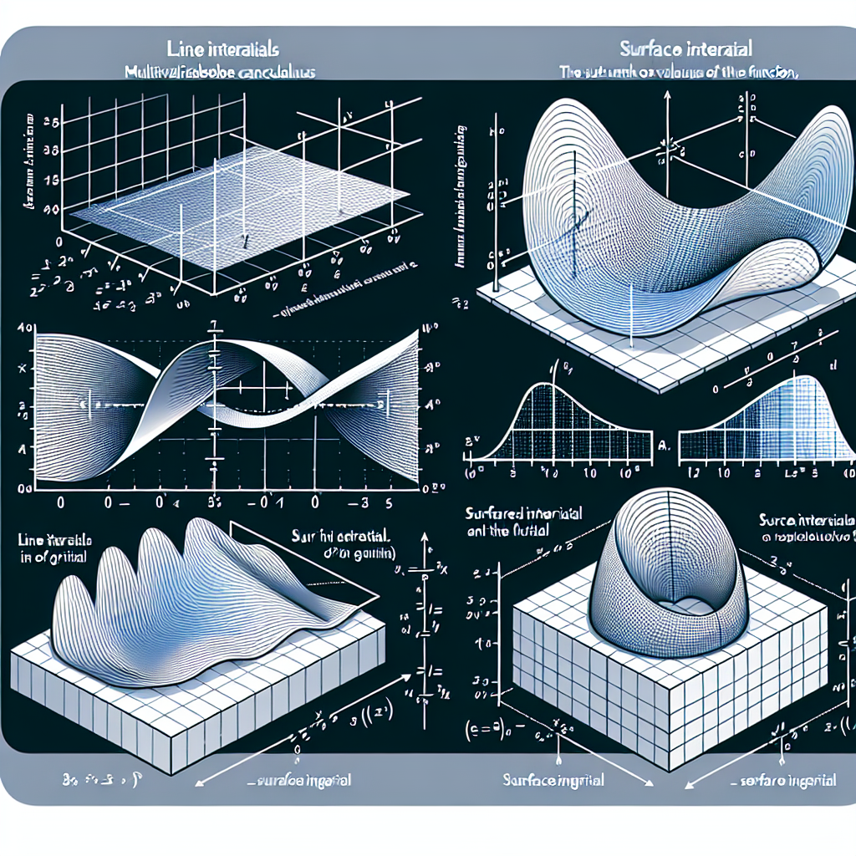
Line and Surface Integrals
Line integrals compute the aggregate effect of a vector field along a curve.
Surface integrals compute the aggregate effect of a vector field across a surface.
These integrals provide insights into quantities such as work, flux, and circulation, and are crucial for understanding electromagnetism and fluid flow.
Line and Surface Integrals

Slide 8
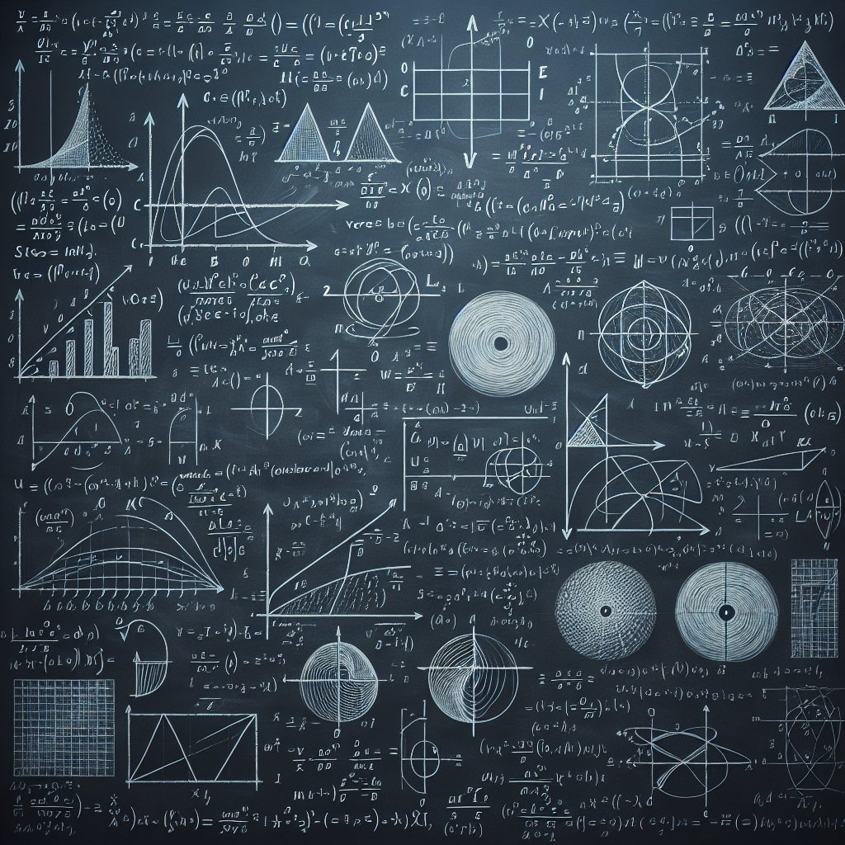
Vector Calculus Theorems
Vector calculus theorems relate integrals of vector fields to the properties of their sources and boundaries.
The divergence theorem relates the flux of a vector field out of a closed surface to the sources within the volume enclosed by the surface.
Stokes' theorem relates the circulation of a vector field around a closed curve to the curl of the field over the surface enclosed by the curve.
These theorems help simplify complex calculations and establish relationships between seemingly unrelated concepts in multivariable calculus.
Vector Calculus Theorems

Slide 9
Optimization in Multivariable Calculus
Optimization involves finding the maximum or minimum values of a multivariable function.
In multivariable calculus, optimization problems often involve finding critical points and determining whether they correspond to local maxima, local minima, or saddle points.
These techniques play a crucial role in fields such as economics, engineering, and physics, where optimizing performance or minimizing costs is paramount.

Slide 10
Applications of Multivariable Calculus
Multivariable calculus has a wide range of applications in various fields.
For example, it is used in physics to describe the motion of particles, analyze electromagnetic fields, and model fluid flow.
In computer graphics, multivariable calculus helps render realistic 3D images and animations.
In economics, it is used in optimization problems to maximize profit and minimize cost.
These applications demonstrate the power and versatility of multivariable calculus in solving real-world problems.

Slide 11
Conclusion
Multivariable calculus provides a powerful framework for understanding and analyzing functions of multiple variables.
It extends the concepts of single-variable calculus to higher dimensions, enabling us to explore the behavior of complex systems and solve diverse problems in various fields.
By applying the principles of multivariable calculus, we can gain deeper insights into the fundamental laws governing the physical, economic, and computational worlds.

Slide 12
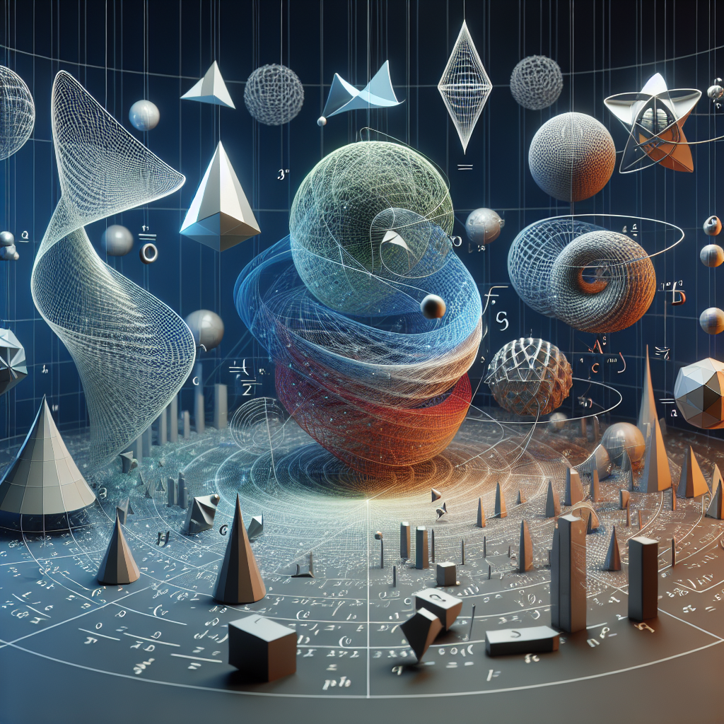
Visualizing Multivariable Calculus
Multivariable calculus can be visually represented using graphs, surfaces, and vector fields.
These visualizations help us understand the geometric and physical interpretations of multivariable functions and their derivatives.
By visualizing multivariable calculus concepts, we can gain intuitive insights and develop a deeper appreciation for the beauty and elegance of this branch of mathematics.
Visualization of Multivariable Calculus

Slide 13
References
1. Stewart, J. (2015). Calculus: Early Transcendentals. Cengage Learning.
2. Anton, H., Bivens, I., & Davis, S. (2009). Calculus: Early Transcendentals. John Wiley & Sons.
3. Edwards, C. H., & Penney, D. E. (2013). Calculus: Early Transcendentals. Pearson.

Slide 14
Thank You
Thank you for your attention!
Any questions?

